Slide 1
组播

Slide 2
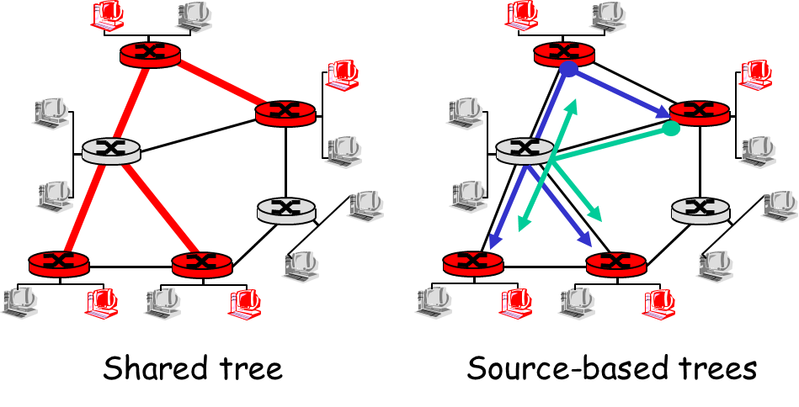
Multicast Routing: Problem Statement
Goal: find a tree (or trees) connecting routers having local mcast group members
tree: not all paths between routers used
source-based: different tree from each sender to rcvrs
shared-tree: same tree used by all group members

Slide 3
Approaches for building mcast trees
Approaches:
source-based tree: one tree per source
shortest path trees
reverse path forwarding
group-shared tree: group uses one tree
minimal spanning (Steiner)
center-based trees

Slide 4
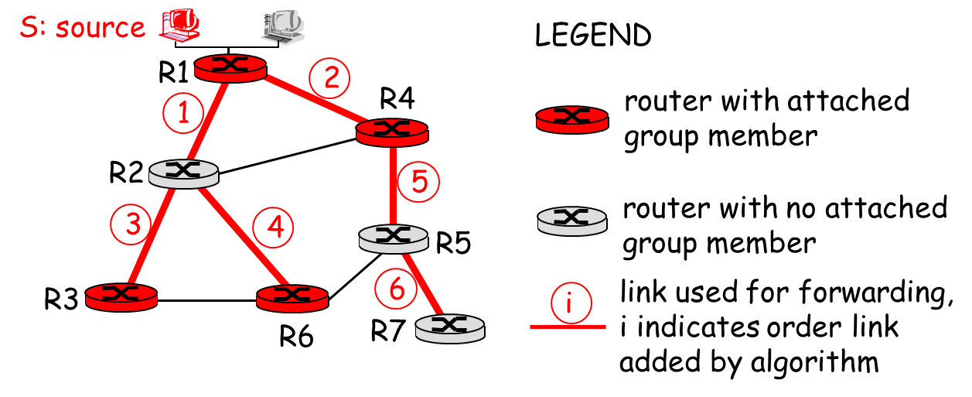
Shortest Path Tree
mcast forwarding tree: tree of shortest path routes from source to all receivers
Dijkstra’s algorithm

Slide 5
Reverse Path Forwarding
rely on router’s knowledge of unicast shortest path from it to sender
each router has simple forwarding behavior:
if (mcast datagram received on incoming link on shortest path back to center)
then flood datagram onto all outgoing links
else ignore datagram

Slide 6
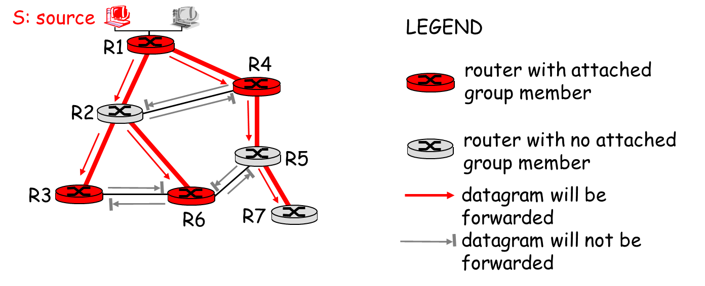
Reverse Path Forwarding: example
result is a source-specific reverse SPT
may be a bad choice with asymmetric links

Slide 7
Shared-Tree: Steiner Tree
Steiner Tree: minimum cost tree connecting all routers with attached group members
problem is NP-complete
excellent heuristics exists
not used in practice:
computational complexity
information about entire network needed
monolithic: rerun whenever a router needs to join/leave

Slide 8
Center-based trees
single delivery tree shared by all
one router identified as “center” of tree
to join:
edge router sends unicast join-msg addressed to center router
join-msg “processed” by intermediate routers and forwarded towards center
join-msg either hits existing tree branch for this center, or arrives at center
path taken by join-msg becomes new branch of tree for this router

Slide 9

Summary
Multicast routing
How to build multicast trees?

